Slide 1
Austin Clean Energy Overview October 21, 2012

Slide 2
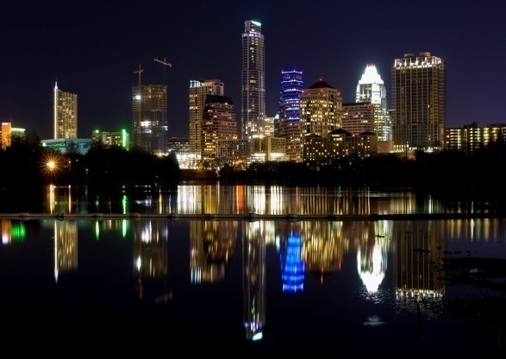
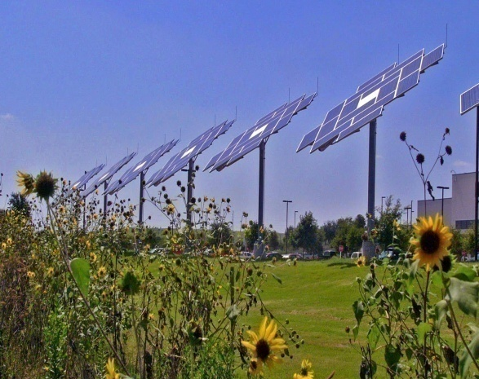
Austin Clean Energy Overview
Prepared Especially For
International Energy Policy Conference
October 26, 2012
Jose Beceiro
Director of Clean Energy
Austin Chamber of Commerce

Slide 3
What is CleanTech?
Power Generation
Wind
Solar
Biofuels / Bioenergy
Geothermal
Tidal / Ocean Current
Energy Efficiency
Solid state lighting (LED’s)
Green building – smart
windows, insulation, HVAC
Low energy computation
Transportation
EV’s, PHEV’s, HEV’s
Energy Storage
Batteries / Ultracapacitors
Fly wheels
Compressed air
Thermal
Energy Infrastructure
Building automation
Smart metering
Smart Grid
Environmental Applications
Water / Wastewater
Air
Recycling / Remediation
Advanced Materials
Organic Solar Cells
Carbon composites
Green Retail
Consumer Goods
Sustainable Food Sources
Electric Bike Rentals
Green Financial Services

Slide 4
Austin’s Clean Energy Industry
3M
Actacell
Active Power
Advanced Micro Devices
Applied Materials
Austin BioFuels
Austin Energy
Cielo Wind Power
Cirrus Logic
CleanFuel USA
CTSI
E.ON
EEstor
ERCOT
Fallbrook Technologies
Freescale Semiconductor
FTL Solar
Green Mountain Energy
Heliovolt
IBM
Ideal Power Converters
Illumitex
Incenergy
Joule Unlimited
Lincoln Renewable Energy
Meridian Solar
National Scooter Company
Nuventix
Pioneer Green Energy
RES Americas
RRE Austin Solar
Site Controls
Skyonic
SolarBridge Technologies
SunPower Corporation
TECO-Westinghouse
Tokyo Electron
Valence Technology
Venti Energy
Xtreme Power
200 + Companies
20,000 Employees

Slide 5
Austin’s Green Tech Trend
Past
Energy R&D
High tech footprint
Austin-owned utility
Consortia
Environmental advocacy
Future
Leading edge research
World renowned talent
Green tech corporate HQs
Corporate green accountability
Major government policy
Smart grid municipal utility
Present
Clean energy R&D
Entrepreneurial environment
Local public policy incentives
Social green movement inertia
Green product innovation

Slide 6
Texas: The Energy Capital
Texas has been the global leader in the energy industry for over 100 years and is committed to leading the way in renewable energy
Largest generator of wind power in the nation
Enough installed wind capacity to power 2.5 million homes (10+ GW installed - 2011)
General Land Office has made developing renewable resources a top priority
Texas RPS
5,880 MW by 2015 (already surpassed)
10,000 MW by 2025
500 MW from a renewable source other than wind energy

Slide 7
Infrastructure
Headquarters for the Electric Reliability Council of Texas (ERCOT)
Operates the state’s independent electric grid
Manages the deregulated market for 85% of Texas
ERCOT provides clean energy companies access to the largest energy market in the nation with an independent and deregulated electric grid.

Slide 8
Austin Chamber Initiatives
Clean Energy Council
SXSW Eco Startup Showcase
CleanTX Forum
Solar Energy Entrepreneurs Network (SEEN)
Clean Energy company recruitment, relocation, expansion efforts
Clean energy advocacy efforts
Clean energy strategy alignment: CEI, CTSI, AE, UT Austin, City of Austin, and State of Texas
Pecan Street Project founding board member

Slide 9
Austin Energy
8th largest municipally-owned electric utility in the nation with more than 430,000 customers and $1.3B in annual revenue for the city
Recognized national leader in energy conservation and clean energy programs
Ranked the top green utility in the nation for its GreenChoice renewable power program (9+ years by NREL). Austin has more 100% green-powered businesses than any other city in the U.S.
Green Building Program, (nationally ranked) raises the bar on sustainability and energy efficiency in new construction
On track to meet 35% of Austin’s power needs from renewables by 2020 and deploy a minimum of 200 MW of solar by 2020
Aggressive rebates are in place for consumers and businesses for energy saving appliances, photovoltaic systems, high efficiency lighting, solar hot water systems – $2.00/watt ($2.50/watt local)
Commercial Production Based Incentive (PBI) - $.14/kwh
Value of Solar Compensation - $.128/kwh

Slide 10
Clean Energy Incubator
SustainLane Government ranks Austin as the top city in the U.S. for cleantech incubation
CEI offers an environment dedicated to helping young clean energy companies succeed by attracting funding and turning ideas into reality
200 companies raised more than $1 billion from investors
R&D partnership with the University of Texas and active collaboration with Austin Energy – Beta Test Program
Commercialization of proprietary technology in areas including energy efficiency, energy management, distributed resources, energy storage, fuel cells, microturbines, power quality, alternative fuels and transportation.

Slide 11
Pecan Street, Inc.
Partnership between the City of Austin, Austin Chamber of Commerce, Austin Energy, Environmental Defense Fund and UT Austin to design the energy system of the future
Corporate partners: Best Buy, Freescale, Furukawa, Intel, Landis + Gyr, LG Electronics, Oncor, Oracle, Sony, SunEdison, Texas Gas Service, Underwriters Laboratories, Whirlpool
Mueller Development smart grid demonstration project funded through a $10.4 million grant – 400 homes participating
Austin has the opportunity to play the same role in the evolution of America’s energy economy as with semiconductors
Because Texas has its own grid, Austin is in a unique position to implement technology changes more quickly and offer its electric grid as a real-world proving ground

Slide 12
"Pecan Street's smart grid research is generating incredibly valuable information on how, when and on what customers use energy. It will end up as the single greatest collection of consumer energy data that has been developed in the United States.” Dr. Michael Webber, University of Texas researcher

Slide 13
Pecan Street Consortium
The University of Texas
Freescale
Furukawa
Green Mountain Energy
Intel
Landis + Gyr
LG Electronics
Oncor
Oracle
Sony
SunEdison
Texas Gas Service
UL
Whirlpool

Slide 14
Consumer-Centered Field Trials
Home energy data hubs
Natural gas applications
Advanced air conditioning
Residential PV
Electric vehicles
Data-driven home improvement

Slide 15
August 10, 2011 1-Hour Consumption Data (kW)

Slide 16
August 10, 2011 15-Minute Consumption Data (kW)

Slide 17
August 10, 2011 1-Minute Consumption Data (kW)

Slide 18
Average Daily Load Curve: July 23 to July 29

Slide 19
August 2011 Average Whole-Home Electricity Usage (kW)

Slide 20
August 2011 Average Peak Consumption from Grid (kW)

Slide 21
August 2011 Average Marginal Price of Wholesale Energy

Slide 22
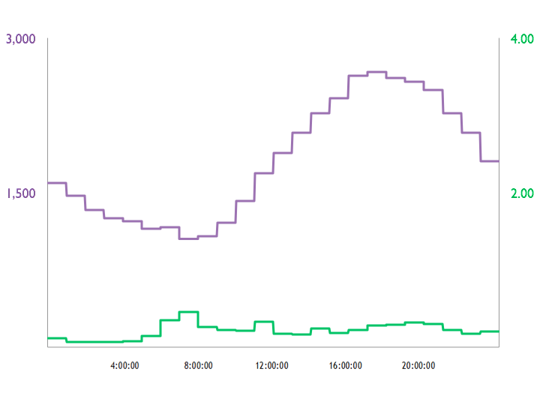
August Average – Natural Gas Usage
Electricity (watts)
Natural gas (ccf)

Slide 23
Pike Powers Commercialization Lab
Research, commercialization, and education
UT faculty and students
UT start-ups
Consortium members
Demonstration

Slide 24
Roadmap
Big data comes to the home
Natural gas air conditioning
Home healthcare
Ductless, zonal AC – control individual rooms
Rooftop solar PV
Home apps

Slide 25
Austin’s Latest Successes
December 2007
“HelioVolt Announces New Solar Plant in Austin”
HelioVolt’s full scale solar panel manufacturing facility created 100+ jobs, $80 million investment, and required 125,000 sf.
HelioVolt specializes in providing a low cost solution for solar generated electricity. They use a non-silicon based solar technology called CIGS which can be applied to a wide variety of products from roof top solar panels to building integrated construction materials.
November 2009
“DOE Awards Austin’s Pecan Street Project $10.4 million for Smart Grid Demonstration at Mueller”
Smart grid technology consortium to design electric grid of the future
The grant will be used to fund an advanced smart grid project at the Mueller development in central Austin
The demonstration project will integrate with Austin Energy’s next generation smart grid platform to create, operate, and evaluate an open platform Energy Internet – a type of smart grid that allows two-way electricity and information flow and is modeled on the architecture of the Internet.

Slide 26
Austin’s Latest Successes
April 2010
“Joule Closes $30 Million Funding Round”
Joule Unlimited opened a $10 million pilot production facility in Leander, TX
The proceeds will help to accelerate Joule’s advancements in a number of areas, including its pilot operations now underway in Leander, Texas, where the production process for its renewable solar fuels, including fungible diesel, will be tested.
December 2010
“SunPower Project Brings 450 New Jobs to Central Texas”
Silicon Valley-based manufacturer of high-efficiency solar cells, solar panels & solar systems employs approximately 5,500 people globally, with more than 900 in the U.S.
Texas will become one of SunPower's top 3 office locations in the U.S.
Austin facility will house operations including marketing, legal and finance functions.
“RRE Power, LLC Breaks Ground on The Pflugerville Solar Farm”
RRE will construct a 60 MW solar farm in Pflugerville, TX
RRE’s project will require 800 acres and $250 million investment
Currently stands as the largest PV solar farm in the nation

Slide 27
Austin’s Latest Successes
April 2011
“FRV Contracts with RES Americas to Build Landmark Project for Austin Energy”
Operation: 30 MW solar farm in Webberville, TX
Jobs: 10
Investment: $110 Million
Real Estate: ~ 300 acres
Incentives: Village of Webberville & Travis County providing 80% property tax abatements for 20 years
RES Americas Inc., a unit of U.K.-based Renewable Energy Systems Ltd., will build the Webberville solar plant and provide maintenance services for five years.
Austin Energy agrees to purchase the electricity generated by the project for 25 years
Webberville is located 15 miles east of Austin, Texas, and the project is expected to be completed by the end of this year.
Germany’s second-biggest state-owned lender Bayerische Landesbank provided financing
The Webberville project will use panels from Changzhou, China-based Trina Solar Ltd. (TSL) that will follow the sun using single-axis tracking systems to increase power output.

Slide 28
Austin’s Latest Successes
October 2011
“Complete Energy Systems to bring 230 jobs to Region”
Operation: Mobile power units & solar module mfg
Jobs: 230
Investment: $13.4 Million
Real Estate: 80,000 sq. ft.
Incentives: City of Pflugerville; Skills Development Fund
CES will receive a 50 percent property tax rebate from the city for five years, up to $375,000. In addition, the economic development corporation has agreed to pay the company $3,000 per job created, up to $750,000, as well as $75,000 in moving expenses.
CES manufactures mobile power trailers and units that provide power, refrigeration, and will be deployed in Africa and other remote areas to serve as medical clinics, food trailers, refrigerators, water purifiers, and other applications. The mobile power units operate completely off-grid and feature micro wind turbines, solar panels, energy storage, and LED lighting.

Slide 29
Austin’s Latest Successes
December 2011
“Superconductor Technologies to Relocate Corporate Headquarters to Austin, TX”
Operation: Advanced transmission line technology HQ and R&D facility
Jobs: 135
Investment: $65 Million
Real Estate: 94,000 sq. ft.
Incentives: Skills Development Fund
STI was founded by Robert Schrieffer, Nobel Laureate in Superconducting theory and founding father of STI, who began the company in 1987 with a mission to commercialize High Temperature Superconductors
STI’s new Austin HQ will be a state of the art facility and will be the home of STI’s Conductus superconducting wire manufacturing center of excellence

Slide 30
THANK YOU!
www.austinchamber.com
Austin Chamber of Commerce
Jose Beceiro
Director of Clean Energy
512.322.5611
jbeceiro@austinchamber.com

